Slide 1

Computer Graphics
CS C 471 and IS C 471
Dr. Lucy J. Gudino
Computer Science & Information Systems Group
Birla Institute of Technology & Science, Pilani, Goa Campus

Slide 2
Illumination

Slide 3
Introduction
Color of the physical surface depends on the perception of the eye
  color depends on the distribution of photon energies that arrive and trigger your cone cells.
  Photons come from light source or combination of sources
  Some are absorbed and some are reflected by the surface
  Two components of illumination/lighting: light sources and surface properties

Slide 4
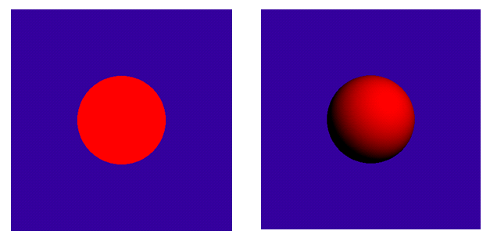

Why Lighting
3D without lighting
3D with lighting

Slide 5
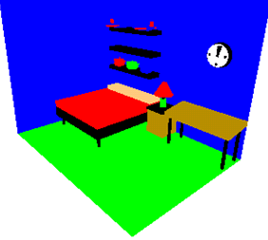
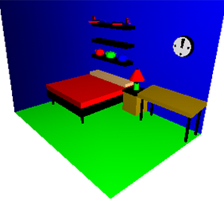
Why Lighting
3D without lighting
3D with lighting

Slide 6
Components of Illumination
Light sources (or emitters)
  Spectrum of emittance (i.e., color of the light)
  Brightness
  Geometric attributes
    Position
    Direction
    Shape
  Directional attenuation
  Polarization : how light diverges

Slide 7
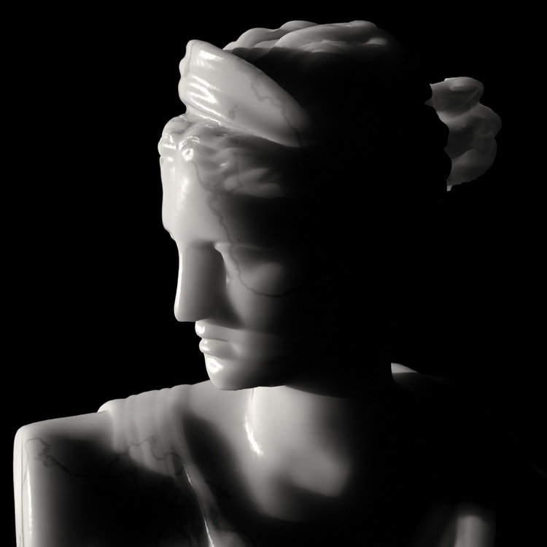
Contd…
Surface properties
  Reflectance spectrum (i.e., color of the surface)
  Geometric attributes
    Position
    Orientation
    Micro-structure

Slide 8
Light Sources
Ambient
Directional
Point
Spot

Slide 9
Ambient Light Sources
Objects not directly lit are typically still visible
  E.g., the ceiling in this room, undersides of desks
This is the result of indirect illumination from emitters, bouncing off intermediate surfaces
Too expensive to calculate (in real time), so we use a hack called an ambient light source
  No spatial or directional characteristics; illuminates all surfaces equally
  Amount reflected depends on surface properties

Slide 10
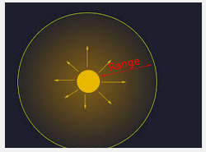
Point Light Sources
The point light source emits rays in radial directions from its source.
It is emitting light in all directions equally.
A point light source is a fair approximation to a local light source such as a light bulb.
Emits single color, specified with three RGB components

Slide 11
Directional Light Sources
All of the rays from a directional light source have a common direction, and no point of origin.
Light is not emitted from a specific point in the world but from infinity so light is coming in parallel.
It is as if the light source was infinitely far away from the surface that it is illuminating.
Sunlight is an example of an infinite light source.

Slide 12
Spotlights
A strong beam of light that illuminates only a small area
It is similar to a point light in that it has colors, attenuation and a position, but spot lights have an additional direction and angle which will define the area that is lit.
Requires a color, a point, a direction, parameters that control the rate of fall off

Slide 13
Components of Reflections
lighting model considers the lighting to be divided into four independent components:
  Emissive
  Ambient
  Diffuse
  Specular

Slide 14
Emissive color : This is the self-illumination color an object has.
Ambient color : Ambient color is the color of an object when it is in shadow.
  This color is what the object reflects when illuminated by ambient light rather than direct light.
Diffuse color :Diffuse color is the most instinctive meaning of the color of an object.
  It is that essential color that the object reveals under pure white light.
  It is perceived as the color of the object itself rather than a reflection of the light.

Slide 15
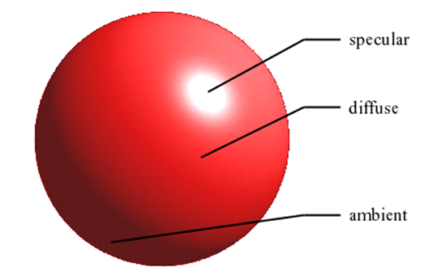
Contd…
Specular color :Specular color is the color of the light of a specular reflection (specular reflection is the type of reflection that is characteristic of light reflected from a shiny surface).
Notes:
Backlighting in a room has a large ambient component, since most of the light that reaches your eye has first bounced off many surfaces. A spotlight outdoors has a tiny ambient component; most of the light travels in the same direction, and since you're outdoors, very little of the light reaches your eye after bouncing off other objects. When ambient light strikes a surface, it's scattered equally in all directions.

Slide 16
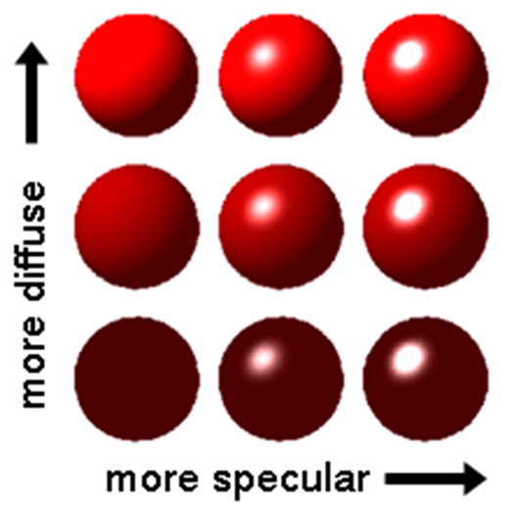
Contd…

Slide 17

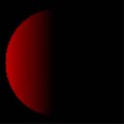
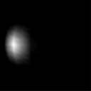
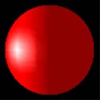
Contd…
+
+
=
Ambient
(colour)‏
Diffuse
(directional)‏
Specular
(highlights)‏
R_{c}

Slide 18
Material Color
material's color depends on the percentages of the incoming red, green, and blue light it reflects.
Ex: red ball
  Reflects red color
  Absorbs green and blue
If the light is white ➔ red ball
If the light is pure red light ➔ red ball
If the light is green ➔ black ball ?

Slide 19
Contd…
materials have different ambient, diffuse, and specular colors, which determine the ambient, diffuse, and specular reflectances of the material
Ambient and diffuse reflectances define the color of the material and are typically similar if not identical.
Specular reflectance is usually white or gray, so that specular highlights end up being the color of the light source's specular intensity.

Slide 20
Contd…
In addition, materials have an emissive color, which simulates light originating from an object

Slide 21
Create, Position, and Enable One or More Light Sources
glLightfv()
void glLightf(GLenum light, GLenum pname, GLfloat param);
void glLighti(GLenum light, GLenum pname, GLint param);

Slide 22
Contd…
glLightfv()
void glLightf(GLenum light, GLenum pname, GLfloat param);
void glLighti(GLenum light, GLenum pname, GLint param
Light : Specifies a light.
The number of light depends on the implementation, but at least eight lights are supported.
They are identified by symbolic names of the form GL_LIGHT i,
where i ranges from 0 to the value of GL_MAX_LIGHTS - 1.

Slide 23
glLightfv()
void glLightf(GLenum light, GLenum pname, GLfloat param);
void glLighti(GLenum light, GLenum pname, GLint param
Pname: ten light parameters are as follows:
  GL_AMBIENT
  GL_DIFFUSE
  GL_SPECULAR
  GL_POSITION
  GL_SPOT_DIRECTION
  GL_SPOT_EXPONENT
  GL_SPOT_CUTOFF
  GL_CONSTANT_ATTENUATION
  GL_LINEAR_ATTENUATION
  GL_QUADRATIC_ATTENUATION

Slide 24
glLightfv()
void glLightf(GLenum light, GLenum pname, GLfloat param);
void glLighti(GLenum light, GLenum pname, GLint param );
param
Specifies a pointer to the value or values that parameter pname of light source light will be set to.

Slide 25
Contd…
GL_AMBIENT: params contains four integer or floating-point values that specify the ambient RGBA intensity of the light. Default value (0,0,0,1)
GL_DIFFUSE: params contains four integer or floating-point values that specify the diffuse RGBA intensity of the light
Notes:
Alpha Blending

Slide 26
Contd…
GL_SPECULAR: params contains four integer or floating-point values that specify the specular RGBA intensity of the light
  The initial value for GL_LIGHT0 is (1, 1, 1, 1); for other lights, the initial value is (0, 0, 0, 1).
GL_POSITION
  The initial position is (0, 0, 1, 0);

Slide 27
Contd…
To enable and disable lighting calculation, call glEnable and glDisable with argument GL_LIGHTING. Lighting is initially disabled.
When it is enabled, light sources that are enabled contribute to the lighting calculation. Light source i is enabled and disabled using glEnable and glDisable with argument GL_LIGHTi.

Slide 28
